Slide 1
JSON Serialization

Slide 2
Serialization/Deserialization
Serialization - conversion of Object data into a format that can be saved and stored for later use. (in a File, or a MemoryStream)
Deserialization - The reverse process of serialization. Taking data from some format and rebuilding it into an object based on that data.
Serialization/Deserialization is used to transfer data between web servers.
We can build an Object written in .NET compliant languages and store it in JSON format, and vice versa
using the DataContractJsonSerializer class

Slide 3
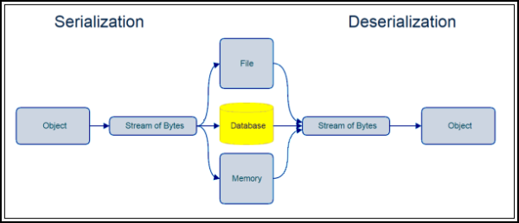

Slide 4
What Is JSON?
JSON - JavaScript Object Notation
Lightweight text format
Easy for humans to read
Easy for computers to parse and generate
Completely language independent
Can be read and used as a data format for any programming language
Common format for serialization

Slide 5
JSON vs XML (Person Object)
<person>
<firstName>John</firstName> <lastName>Doe</lastName>
</person>
JSON doesn’t use end tags
JSON is shorter
JSON is easier to read and write
{ "firstName":"John", "lastName":"Doe" }

